Slide 1
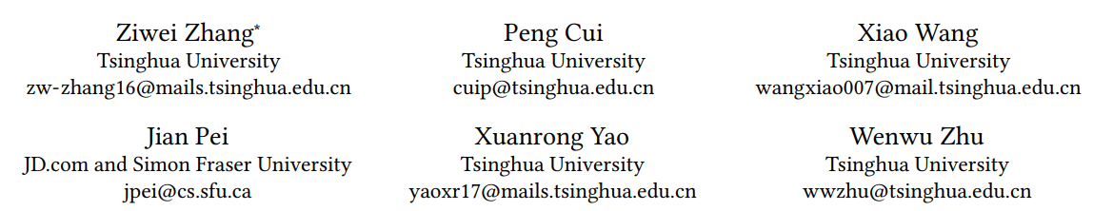
Arbitrary-Order Proximity Preserved Network Embedding

Slide 2
existing methods
all the existing methods can only preserve fixed-order proximities
even given a certain order proximity, it is still an open issue for the existing methods to guarantee accuracy and efficiency simultaneously
proposed methods
our method has a low marginal cost in shifting the embedding vectors across different orders and weights
given a certain order, our method can get the global optimal solutions
the overall time complexity of our method is linear with respect to network size

Slide 3



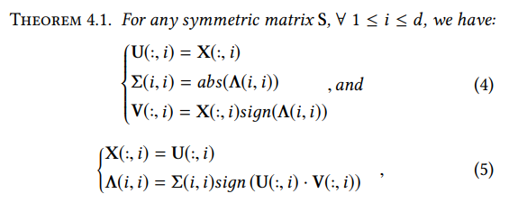


Problem Transformation

Slide 4
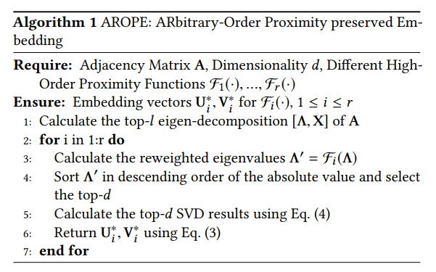


Slide 5


Special Cases of the Proposed Method
Common Neighbors and Propagation
Katz Proximity

Slide 6
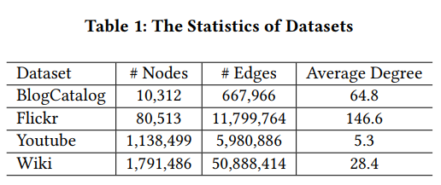
Experimental Setting
BASELINE：
DeepWalk uses truncated random walks
LINE preserves the first two order proximities
Node2vec generalizes DeepWalk by adopting potentially biased random walks
SDNE adopts a deep auto-encoder to preserve the first two order proximities
NEU enhancing other network embedding vectors by approximating a higher-order proximity

Slide 7
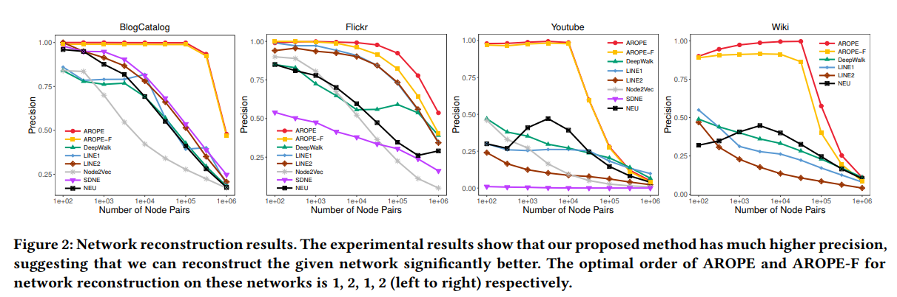

Slide 8
